Slide 1
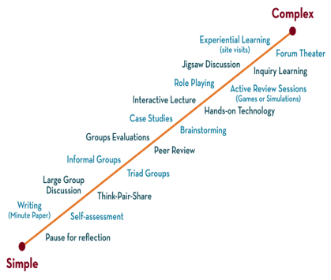
NETWORKS, PROTOCOLS & SECURITY (DNPS) 24EC2210 Topic: SNMP
Session-30

Slide 2



AIM OF THE SESSION
To familiarize the students with the basic concept of the and the working of the simple network management protocol
INSTRUCTIONAL OBJECTIVES
The session is design to understand the:
To understand the concepts of the working of simple network management protocol.
LEARNING OUTCOMES
At the end of this session, you should be able to:
Describe the working of simple network management protocol.

Slide 3
Syllabus
SNMP

Slide 4
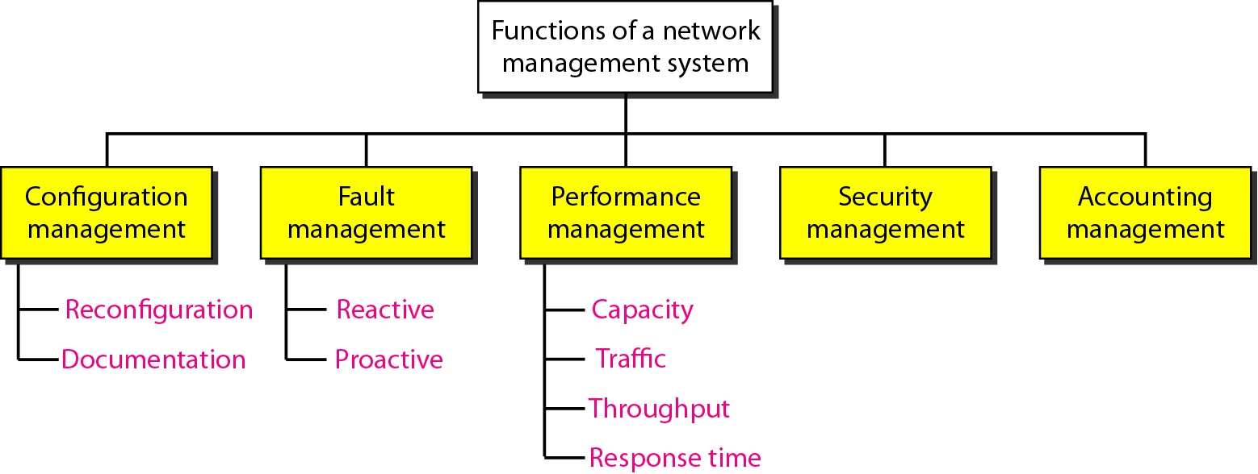
Simple Network Management Protocol (SNMP)
Function of the Network Management System
The functions performed by a network management system can be divided into five broad categories:

Slide 5
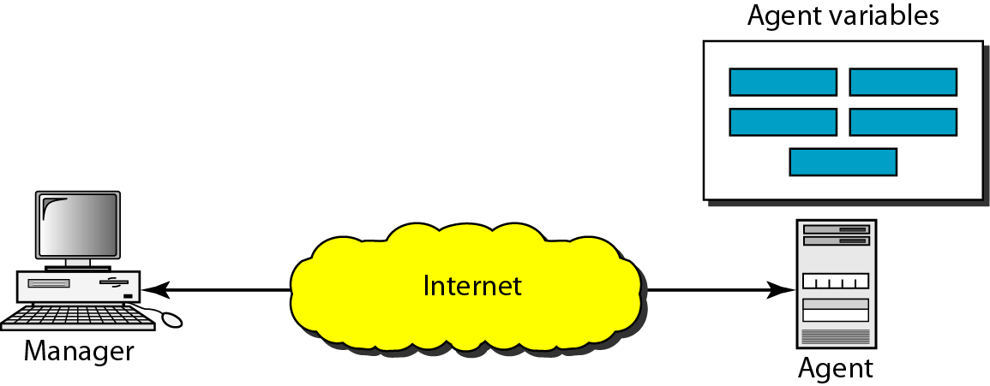
Simple Network Management Protocol (SNMP)
The Simple Network Management Protocol (SNMP) is a framework for managing devices in an internet using the TCP/IP protocol suite. It provides a set of fundamental operations for monitoring and maintaining an internet.
SNMP Concept

Slide 6
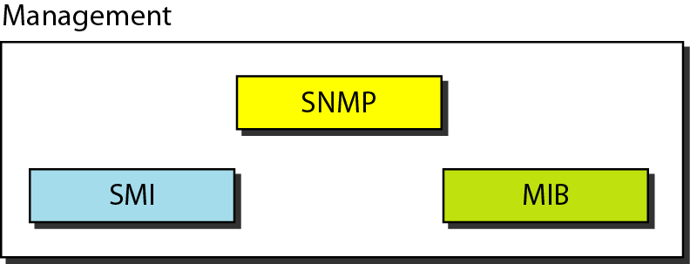
Simple Network Management Protocol (SNMP)
Component of the SNMP

Slide 7
Simple Network Management Protocol (SNMP)
SNMP defines the format of packets exchanged between a manager and an agent. It reads and changes the status (values) of objects (variables) in SNMP packets.
SMI defines the general rules for naming objects, defining object types (including range and length), and showing how to encode objects and values. SMI does not define the number of objects an entity should manage or name the objects to be managed or define the association between the objects and their values.
MIB creates a collection of named objects, their types, and their relationships to each other in an entity to be managed.

Slide 8
Simple Network Management Protocol (SNMP)
We can compare the task of network management to the task of writing a program.
Both tasks need rules. In network management this is handled by SMI.
Both tasks need variable declarations. In network management this is handled by MIB.
Both tasks have actions performed by statements. In network management this is handled by SNMP.

Slide 9
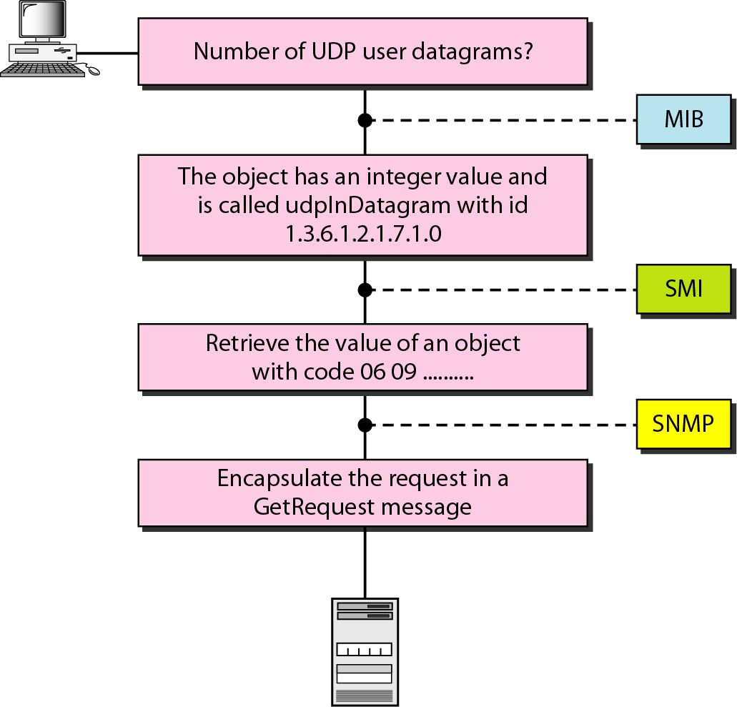
Simple Network Management Protocol (SNMP)
Overview of Managements

Slide 10
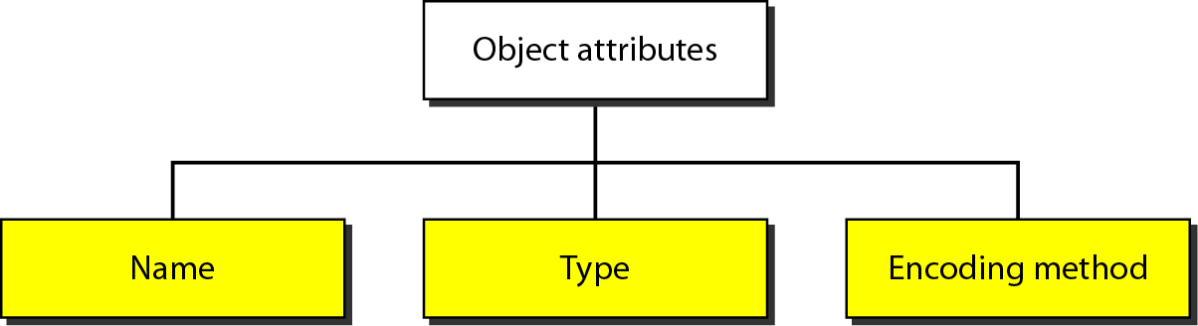
Simple Network Management Protocol (SNMP)
Object Attributes

Slide 11
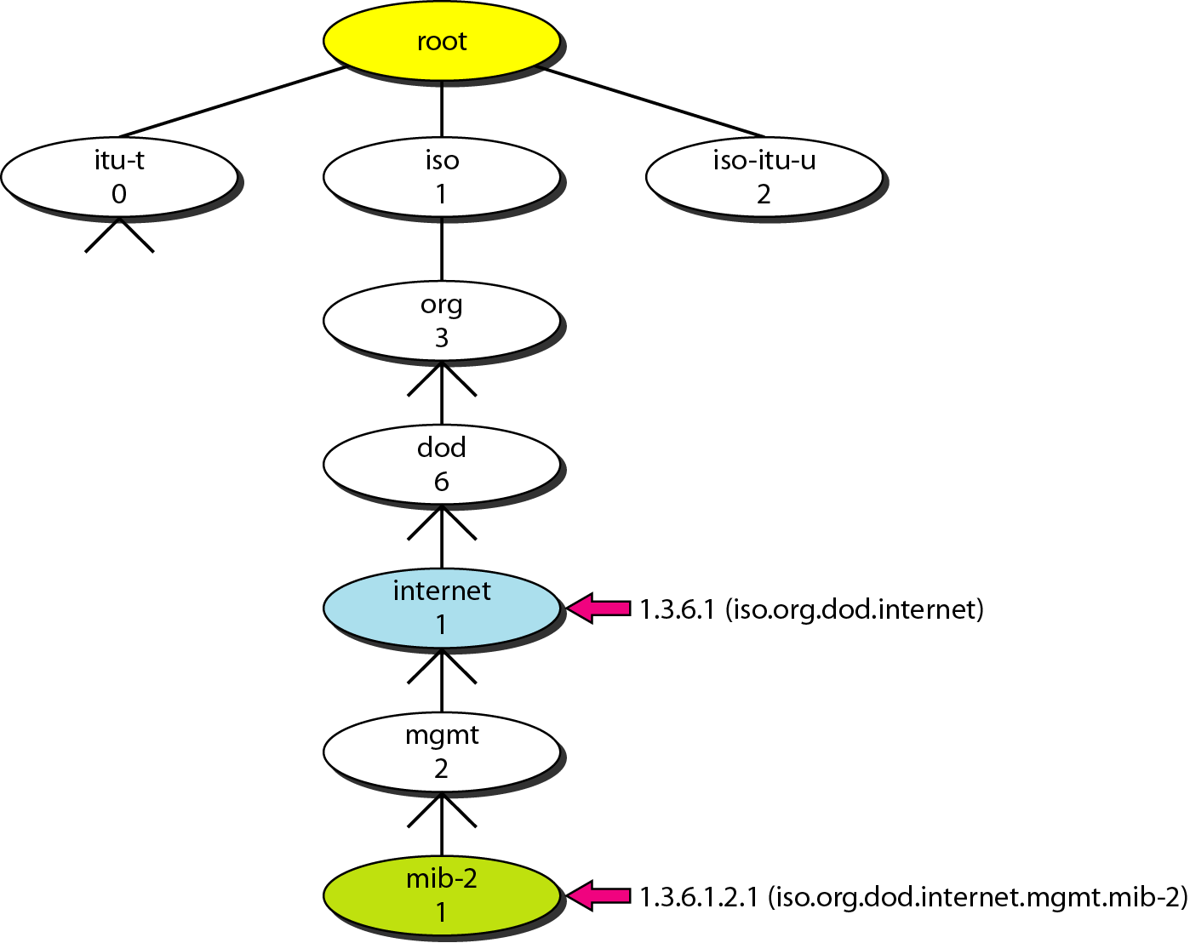
Simple Network Management Protocol (SNMP)
Object Identifier
All objects managed by SNMP are given an object identifier.
The object identifier always starts with 1.3.6.1.2.1

Slide 12
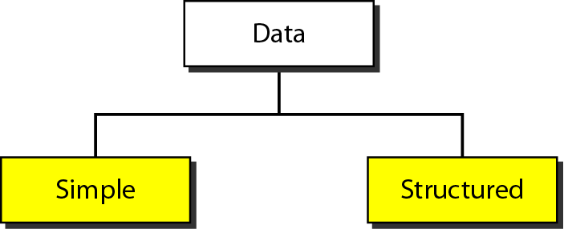
Simple Network Management Protocol (SNMP)
Data Type

Slide 13
Simple Network Management Protocol (SNMP)
Data Type

Slide 14
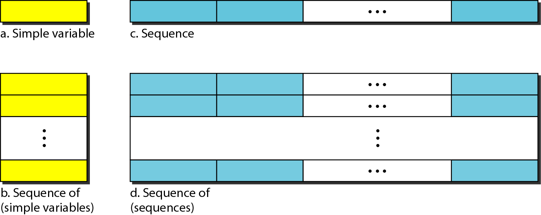
Simple Network Management Protocol (SNMP)
Conceptual Data Type

Slide 15
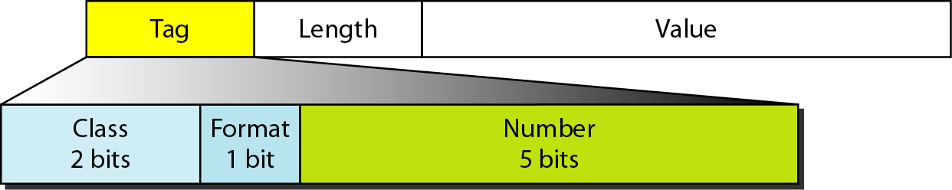
Simple Network Management Protocol (SNMP)
Encoding Format

Slide 16
Simple Network Management Protocol (SNMP)
Codes for data type

Slide 17
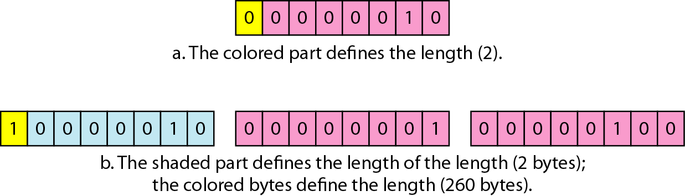
Simple Network Management Protocol (SNMP)
Length Format

Slide 18
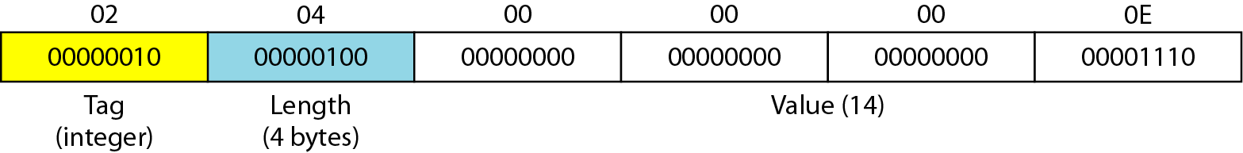
Simple Network Management Protocol (SNMP)
Example
Example to show how to define INTEGER 14

Slide 19
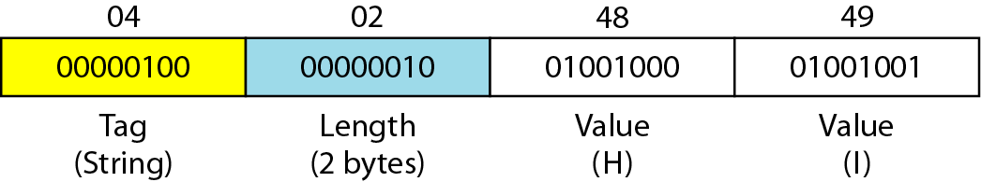
Simple Network Management Protocol (SNMP)
Example to show OCTATE String “HI”

Slide 20
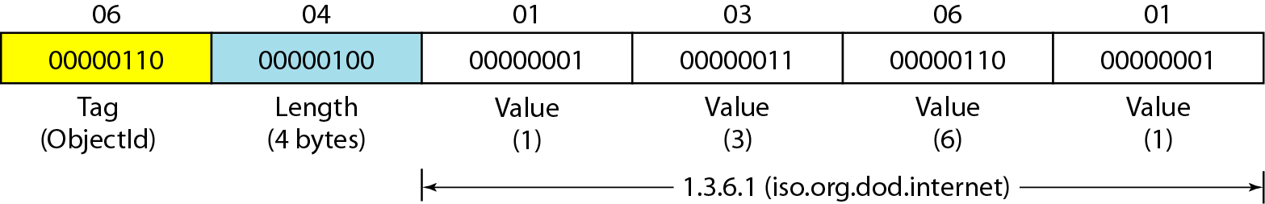
Simple Network Management Protocol (SNMP)
Example to shows how to define Object Identifier 1.3.6.1 (iso.org.dod.internet).

Slide 21
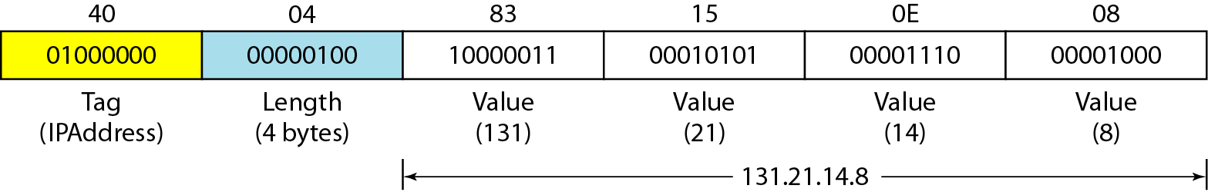
Simple Network Management Protocol (SNMP)
Example to shows how to define IP Address 131.21.14.8

Slide 22
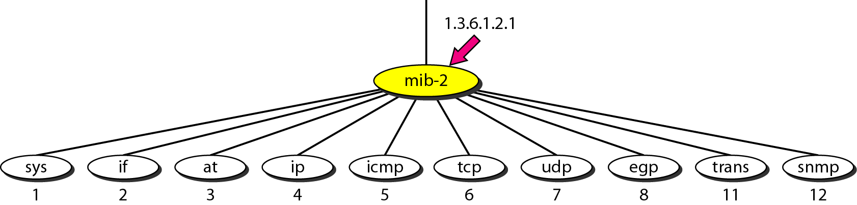
Simple Network Management Protocol (SNMP)
MIB 2

Slide 23
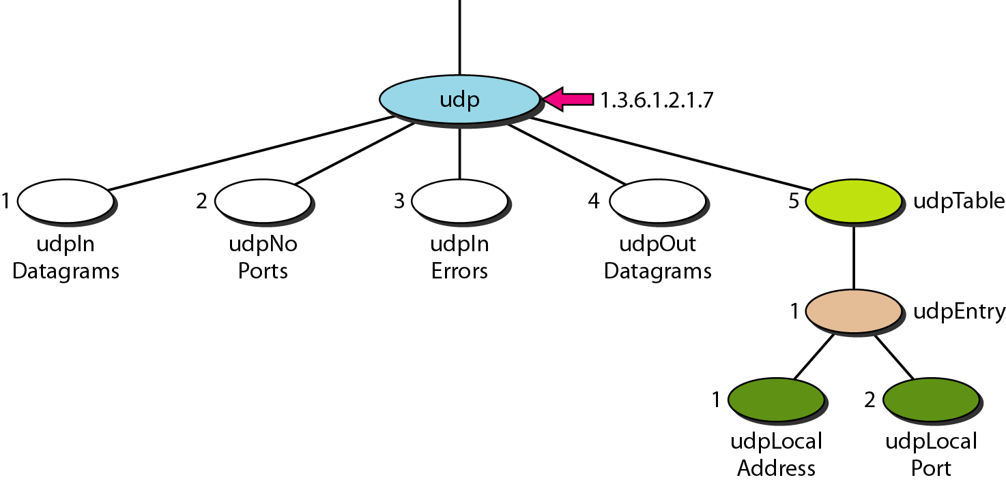
Simple Network Management Protocol (SNMP)
UDP Group

Slide 24
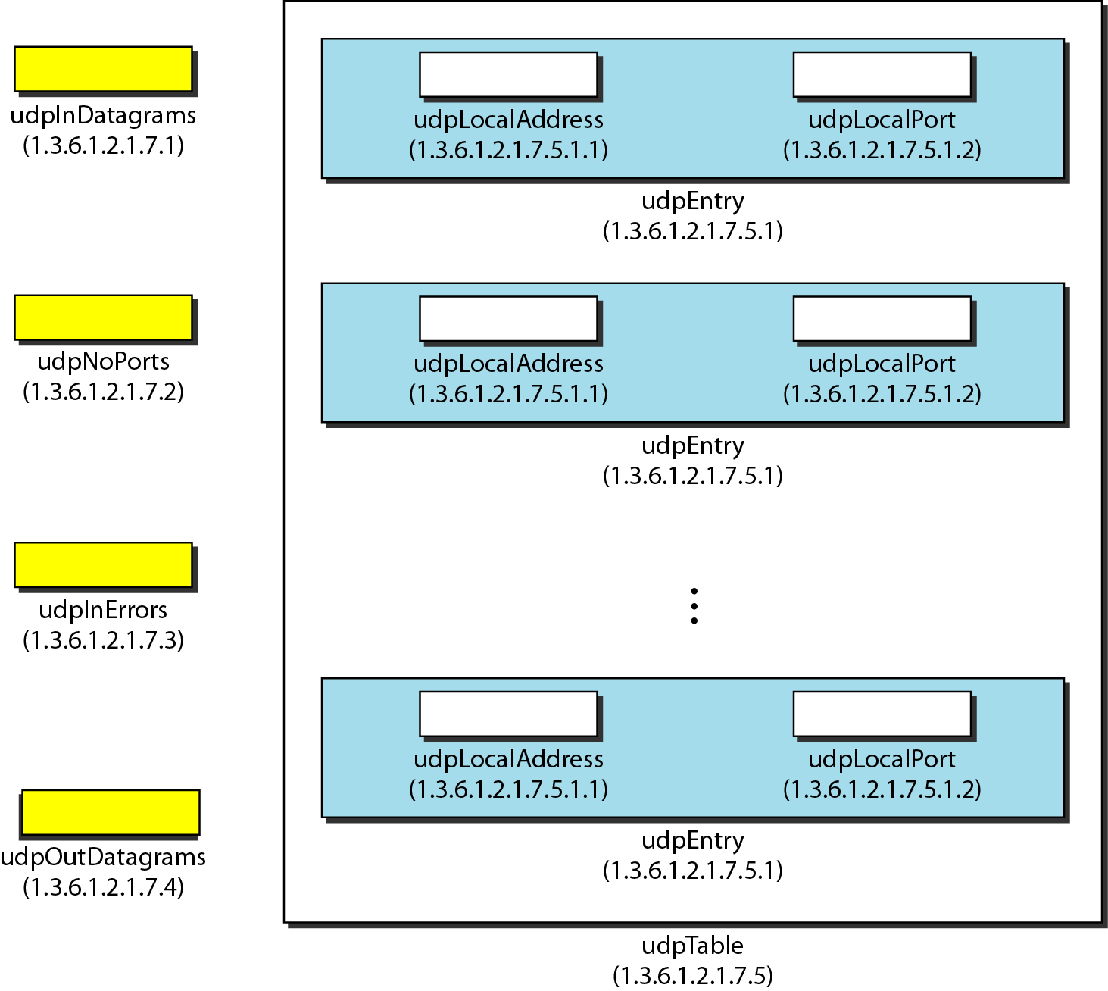
Simple Network Management Protocol (SNMP)
UDP variables and Tables

Slide 25
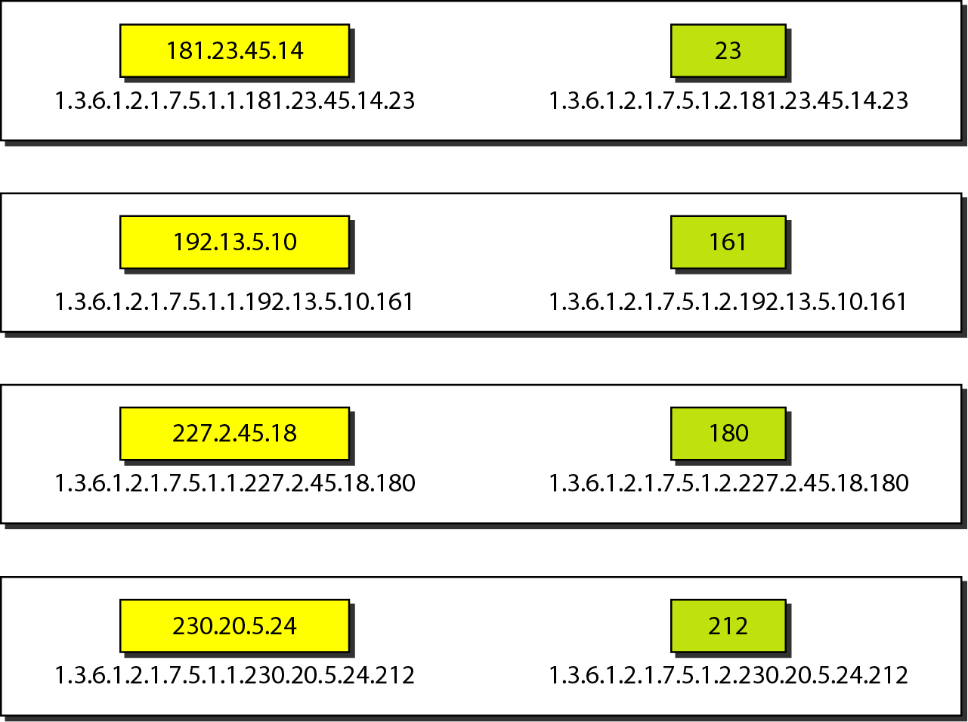
Simple Network Management Protocol (SNMP)
Indexes for UDP table

Slide 26
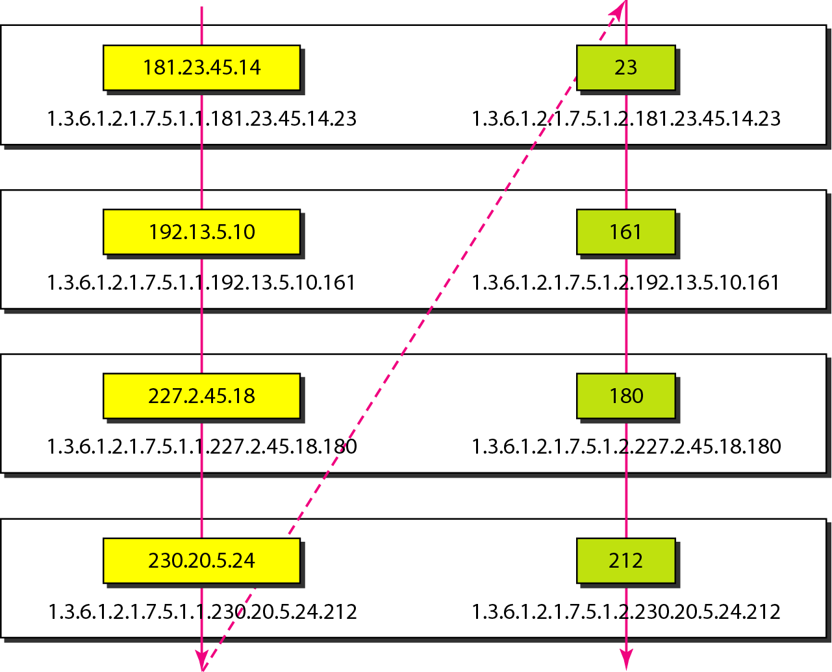
Simple Network Management Protocol (SNMP)
Lexicographic Ordering

Slide 27
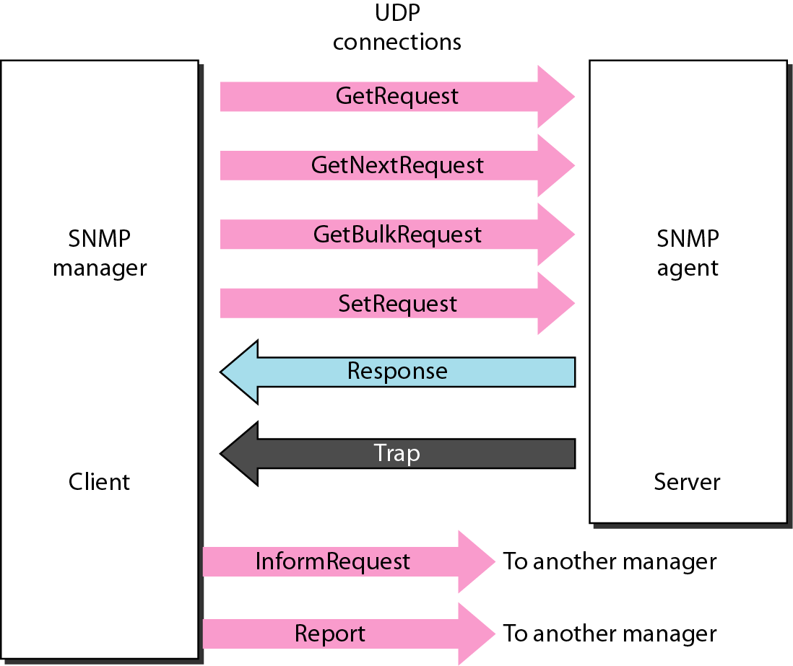
Simple Network Management Protocol (SNMP)
SMTP UDP

Slide 28
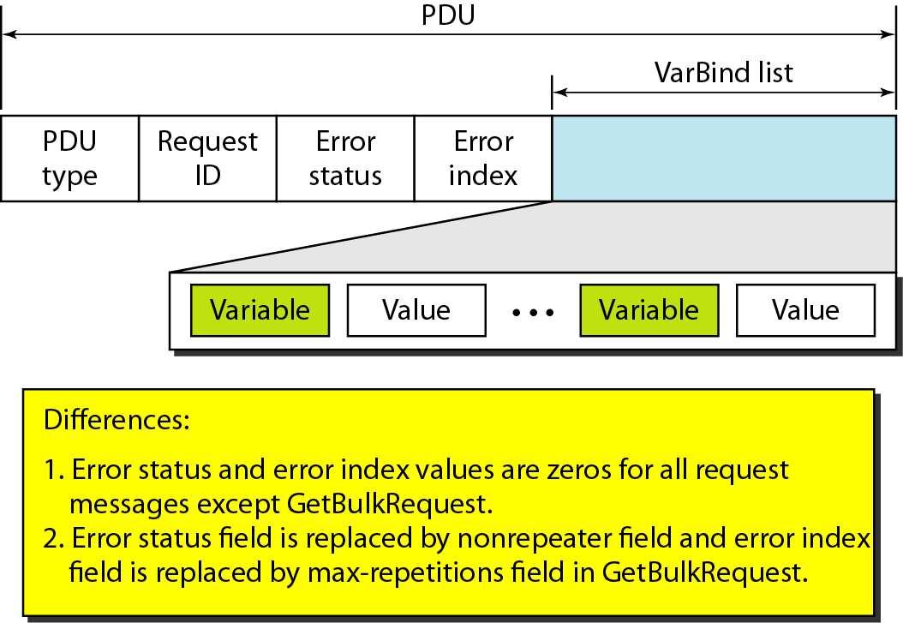
Simple Network Management Protocol (SNMP)
SMTP PDU Format

Slide 29
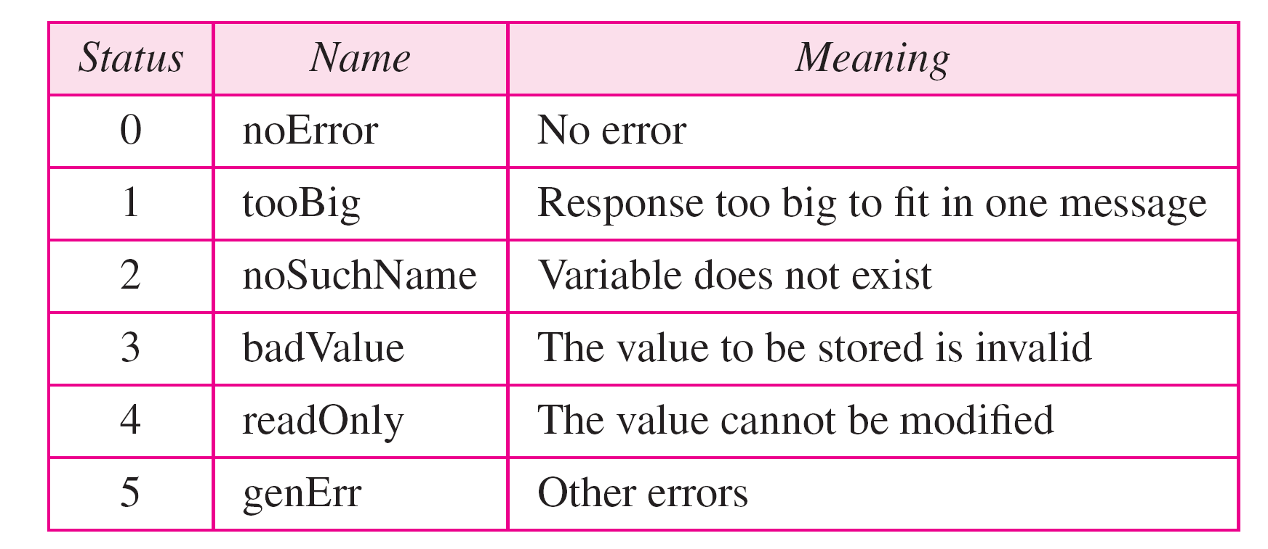
Simple Network Management Protocol (SNMP)
Types of Error

Slide 30
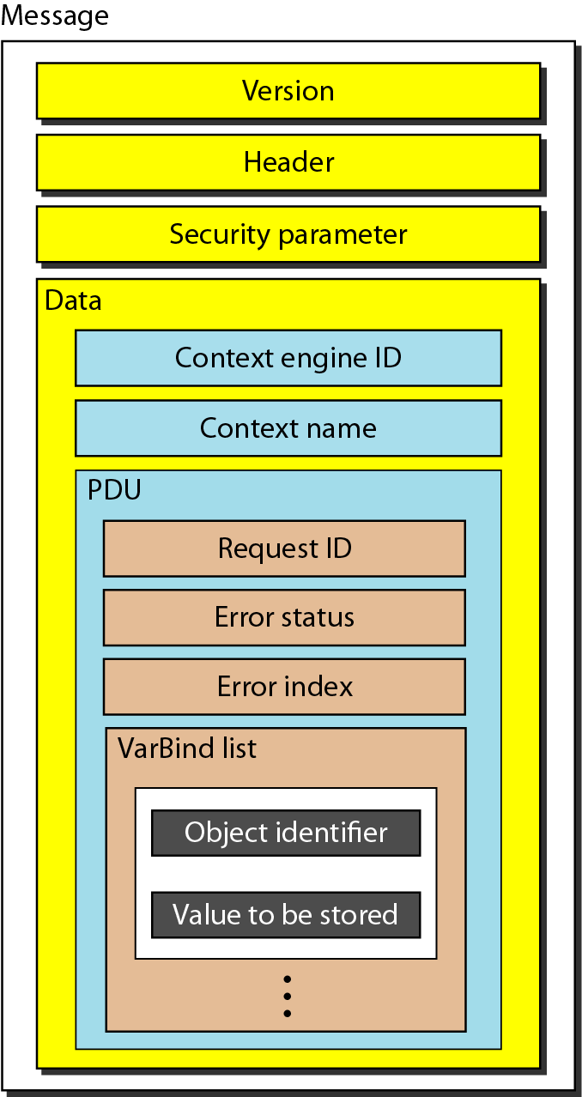
Simple Network Management Protocol (SNMP)
SNMP message

Slide 31
Simple Network Management Protocol (SNMP)
Codes for SNMP message

Slide 32
Simple Network Management Protocol (SNMP)
Example
In this example, a manager station (SNMP client) uses the GetRequest message to retrieve the number of UDP datagrams that a router has received. There is only one VarBind entity. The corresponding MIB variable related to this information is udpInDatagrams with the object identifier 1.3.6.1.2.1.7.1.0. The manager wants to retrieve a value (not to store a value), so the value defines a null entity. Figure 28.23 shows the conceptual view of the packet and the hierarchical nature of sequences. We have used white and colored boxes for the sequences and a gray one for the PDU. The VarBind list has only one VarBind.

Slide 33
Simple Network Management Protocol (SNMP)
Example (Continued)
The variable is of type 06 and length 09. The value is of type 05 and length 00. The whole VarBind is a sequence of length 0D (13). The VarBind list is also a sequence of length 0F (15). The GetRequest PDU is of length ID (29). Now we have three OCTET STRINGs related to the security parameter, security model, and flags. Then we have two integers defining maximum size (1024) and message ID (64). The header is a sequence of length 12, which we left blank for simplicity. There is one integer, version (version 3). The whole message is a sequence of 52 bytes. Figure 28.24 shows the actual message sent by the manager station (client) to the agent (server).

Slide 34
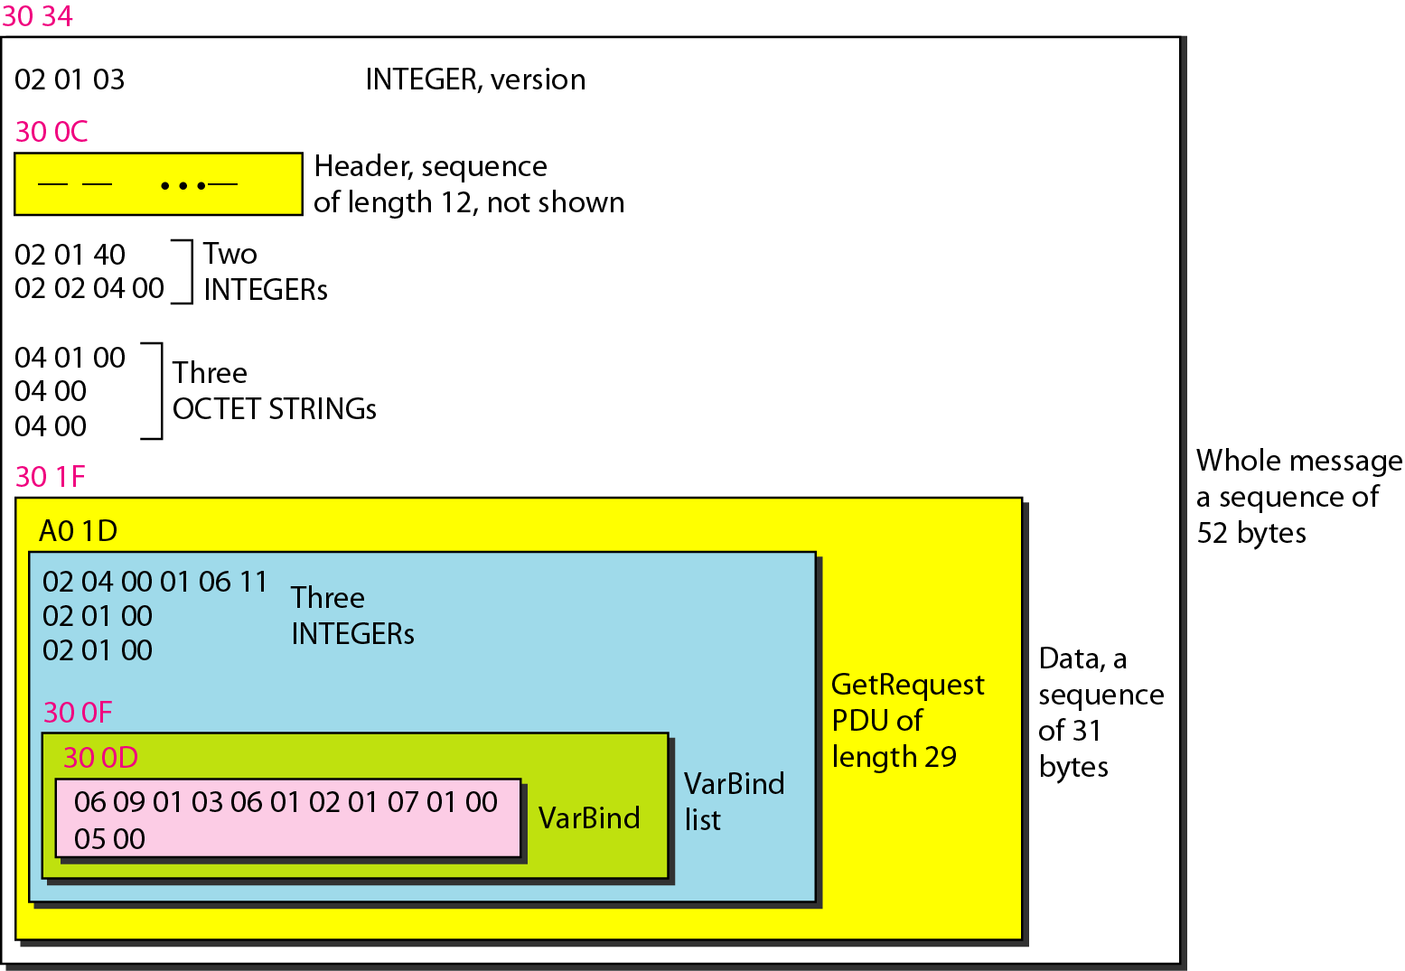
Simple Network Management Protocol (SNMP)

Slide 35
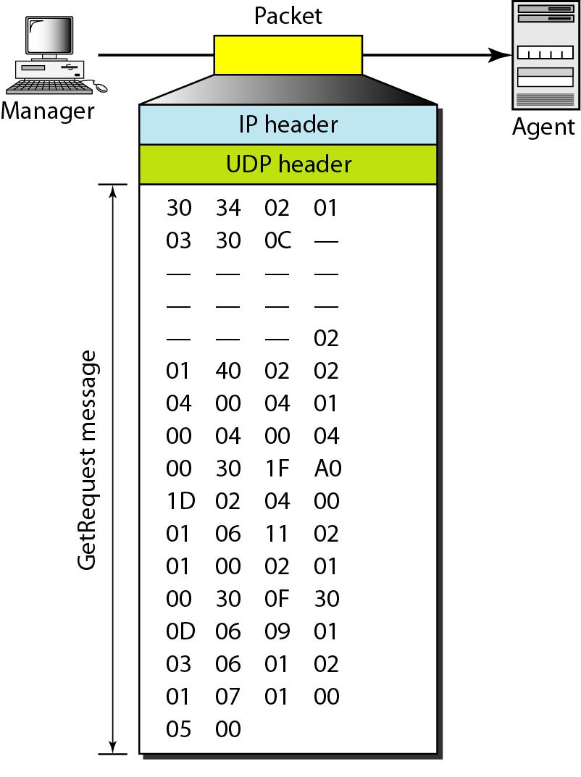
Simple Network Management Protocol (SNMP)
GetRequest Message

Slide 36
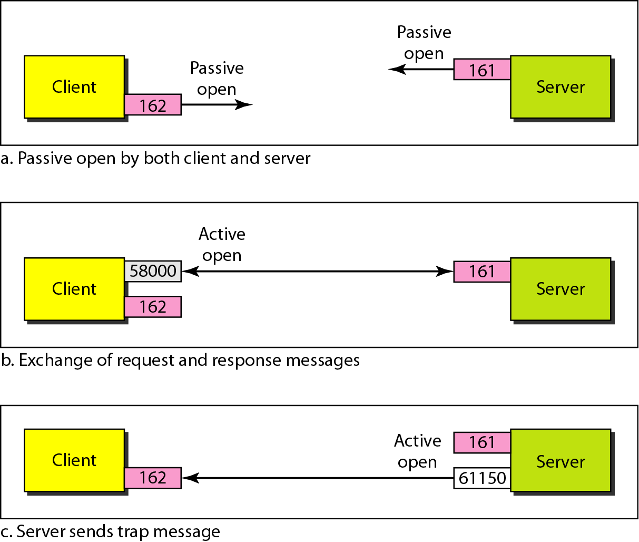
Simple Network Management Protocol (SNMP)
Port Number of SNMP

Slide 37
REFERENCES FOR FURTHER LEARNING OF THE SESSION
Reference Books:
Data Communications and Networking (3rd Ed.) “–B. A. Ferouzan – TMH
Computer Networks (4th Ed.)”, A. S. Tanenbaum – – Pearson Education/PHI
Sites and Web links:
https://www.scaler.com/topics/computer-network/socket-programming/
https://www.geeksforgeeks.org/socket-in-computer-network/
https://www.cloudflare.com/learning/ssl/what-is-ssl/
https://www.geeksforgeeks.org/secure-socket-layer-ssl/
https://www.javatpoint.com/simple-network-management-protocol
https://www.manageengine.com/network-monitoring/what-is-snmp.html

Slide 38

THANK YOU
Team –NETWORK PROTOCOLS & SECURITY (NPS)

